Slide 1
Immigration, Rents, and House Prices in American Metropolitan Areas
Luke Pulaski
25 April 2025
Introduction
Literature Review
Setting
Data
Empirical Analysis
Robustness Checks
Conclusion

Slide 2
Motivation
Immigration is a hotly debated policy issue
Immigrants often demonized for lowering the standard of living of native-born individuals
Immigration is a key driver of demographic and economic shifts
Accounted for about 80% of U.S. population growth in 2024
Much attention is given to the effect of immigration on employment and wages of native workers
Relatively less is known about the effects of immigration on other sectors of the economy (like the housing market)
Housing market is a key indicator of economic viability of U.S.
In U.S., housing costs are on the rise
Since 2011, the median rental rate has increased 19% and the median home value has grown 44%
Much of this growth can be observed in metropolitan areas
Introduction
Literature Review
Setting
Data
Empirical Analysis
Robustness Checks
Conclusion

Slide 3
Contributions
National-level study of the interaction between immigration and the housing market in the United States
Usage of lagged economic controls & U.S.-level instrumental variable to alleviate endogeneity issues
Empirical separation of the effect of immigration on housing market from the effect of native mobility
Testing for heterogeneous effects across the rental rate and house price distribution
Introduction
Literature Review
Setting
Data
Empirical Analysis
Robustness Checks
Conclusion

Slide 4
Key Findings
An increase in immigration equal to 1% of a metropolitan area’s total population results in about a 2% increase in rental rates and a 3% increase in house prices
Immigrants do not seem to be displacing native-born individuals; their migration is complementary
Increases in housing demand directly attributable to immigrants accounts for a small part of the total effect on rental rates and house prices
Partial demand effects are about 80% lower than total demand estimates
Immigration has a substantially larger effect on the upper end of the house price distribution
Introduction
Literature Review
Setting
Data
Empirical Analysis
Robustness Checks
Conclusion

Slide 5
Related Literature
Impact of immigration on labor market:
Key studies: Borjas (1994); Friedberg & Hunt (1995)
Immigrants do not seem to harm the economic well-being of natives in the labor market
Effects vary based on skill levels of immigrants & natives
“Natural Experiments”
Key studies: Card (1990); Saiz (2003); Tumen (2016); Forero-Vargas & Iturra (2023)
Take advantage of migration events where immigrants do not freely choose their destination locations
Effects of exogenous shocks tend to be quite large in the short run
Not comparable to the modern U.S.
Introduction
Literature Review
Setting
Data
Empirical Analysis
Robustness Checks
Conclusion

Slide 6
Related Literature
“Past immigration” technique
Key studies: Partridge, et. al. (2009)
1% increase in immigrant inflow → 0.23% decrease in rental rates
Using foreign-born stock in a base year as an instrument lacks nuance
“Shift-share” instrument variable technique
Key studies: Saiz (2007); Sanchis-Guarner (2023); Helfer, et. al. (2023); Sá (2015); Accetturo, et. al. (2014); Unal, et. al. (2024)
Estimates of the effect of a 1% increase in immigrant inflow vary
Hinges on time frame and geographic location
Introduction
Literature Review
Setting
Data
Empirical Analysis
Robustness Checks
Conclusion

Slide 7
Related Literature
Accounting for impact of native mobility
Key studies: Sá (2015); Card (2001); Wozniak & Murray (2012); Sanchis-Guarner (2023); Unal, et. al. (2024)
Little empirical analysis; Sanchis-Guarner (2023) finds direct demand from immigrants only makes up a fraction of the total demand effect, partial demand effects are only 24% of total demand estimates
Heterogeneous (nonlinear) effects
Key studies: Unal, et. al. (2024); Braakmann (2019)
Rental units at the lower end of the distribution tend to be affected negatively by immigrant inflow
Effect of immigration does not noticeably vary across the house price distribution
Introduction
Literature Review
Setting
Data
Empirical Analysis
Robustness Checks
Conclusion

Slide 8
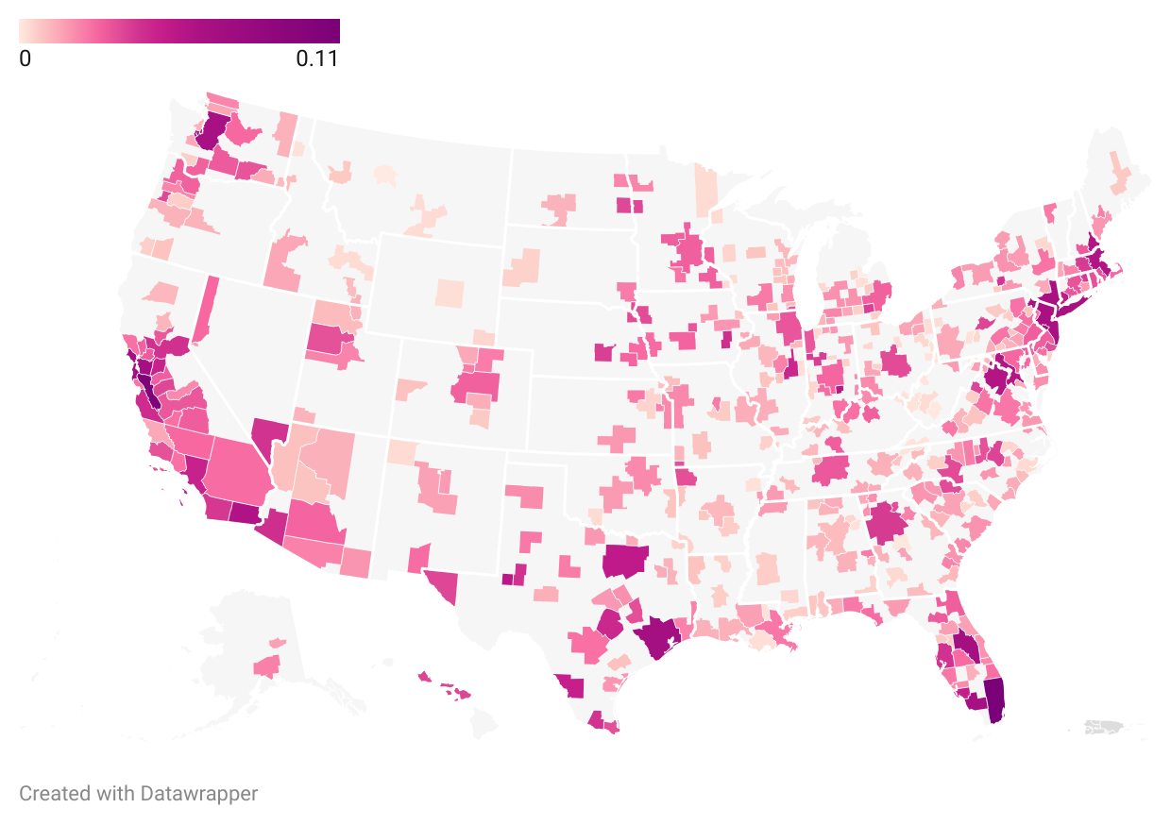
Immigrant Concentration Dynamics
Introduction
Literature Review
Setting
Data
Empirical Analysis
Robustness Checks
Conclusion

Slide 9
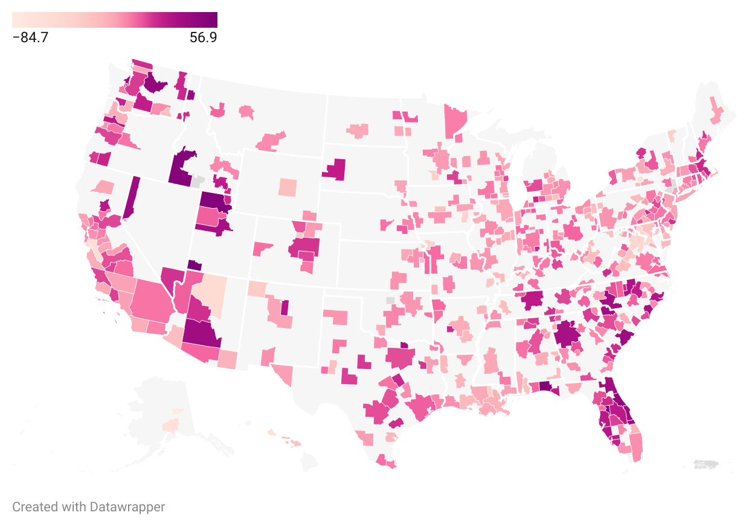
Rental Rate Dynamics
Introduction
Literature Review
Setting
Data
Empirical Analysis
Robustness Checks
Conclusion

Slide 10
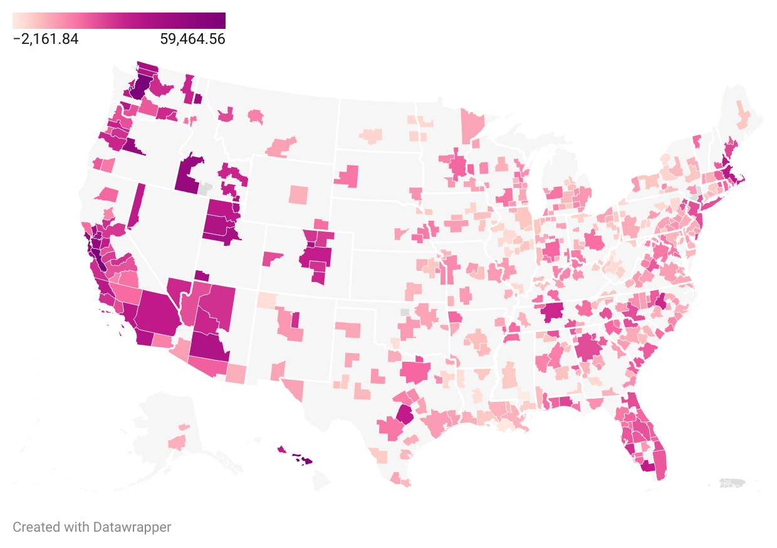
House Price Dynamics
Introduction
Literature Review
Setting
Data
Empirical Analysis
Robustness Checks
Conclusion

Slide 11
Overall Trends
MSAs with large increases in immigrant concentration also tend to experience large increases in rental rates or house prices
Strength of association seems to vary nationwide
Introduction
Literature Review
Setting
Data
Empirical Analysis
Robustness Checks
Conclusion

Slide 12
Time Frame & Observations
Sample of 381 metropolitan statistical areas (MSAs)
Yearly data from 2013 to 2022
Office of Management and Budget changes MSA boundaries (if necessary) 3 years after each decennial census
Unit of observation = MSA-year
Introduction
Literature Review
Setting
Data
Empirical Analysis
Robustness Checks
Conclusion

Slide 13
Primary Sources
U.S. Census Bureau American Community Survey (ACS)
Immigration (Foreign-born population that entered the U.S. after 2010
Median contract rent
Median home value
Educational attainment
Percent of employed workers that are employed in agriculture, construction, and manufacturing sectors (industrial composition)
U.S. Bureau of Economic Analysis
Per capita personal income
U.S. Bureau of Labor Statistics
Unemployment
Introduction
Literature Review
Setting
Data
Empirical Analysis
Robustness Checks
Conclusion

Slide 14

Construction of Immigration Variable
$$\frac{{immigration}_{i, t−1}}{{population}_{i,t−2}}$$
immigration = change in the foreign-born population that entered the U.S. after 2010 in MSA i in year t-1
population = total population of MSA i in year t-2
Lagging the immigration variable alleviates some of the reverse causality between immigration and housing market outcomes
Introduction
Literature Review
Setting
Data
Empirical Analysis
Robustness Checks
Conclusion

Slide 15
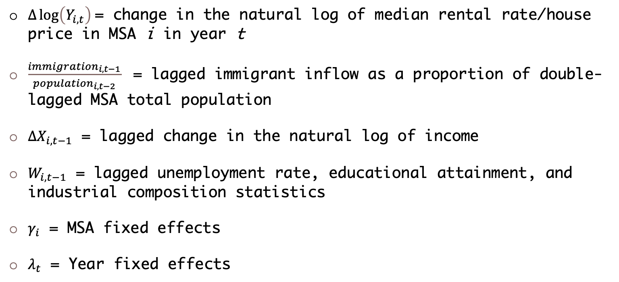
Ordinary Least Square (OLS) Model
$$∆\log\left(Y_{i,t}\right)=β × \frac{{immigration}_{i, t−1}}{{population}_{i,t−2}}+α×{∆X}_{i,t−1}+π×W_{i,t−1}+ γ_{i}+λ_{t}+ε_{i,t}$$
$∆\log\left(Y_{i,t}\right)$= change in the natural log of median rental rate/house price in MSA i in year t
$\frac{{immigration}_{i, t−1}}{{population}_{i,t−2}}$ = lagged immigrant inflow as a proportion of double-lagged MSA total population
${∆X}_{i,t−1}$ = lagged change in the natural log of income
$W_{i,t−1}$ = lagged unemployment rate, educational attainment, and industrial composition statistics
$γ_{i}$ = MSA fixed effects
$λ_{t}$ = Year fixed effects
Introduction
Literature Review
Setting
Data
Empirical Analysis
Robustness Checks
Conclusion

Slide 16
OLS Specification - Results
A 1% increase in immigration relative to MSA population is associated with a 0.502% increase in rental rates and a 0.441% increase in house prices
House price estimate is insignificant
These estimates cannot be interpreted causally because the location decisions of immigrants are not random
Immigrants may be attracted to MSAs where house prices are growing more slowly or even declining
They may want to settle in a location where housing is more affordable
Immigrants may be attracted to MSAs where house prices are growing faster
They may associate rental rate and/or house price increases with a healthy economy and more employment opportunities
Introduction
Literature Review
Setting
Data
Empirical Analysis
Robustness Checks
Conclusion

Slide 17
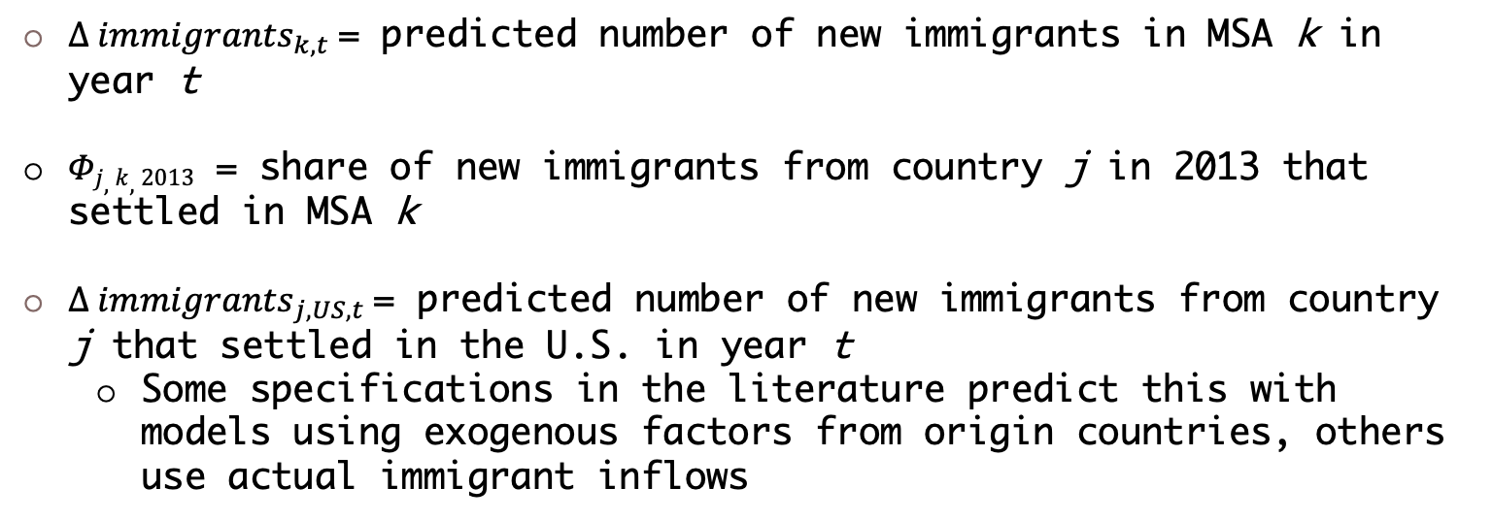
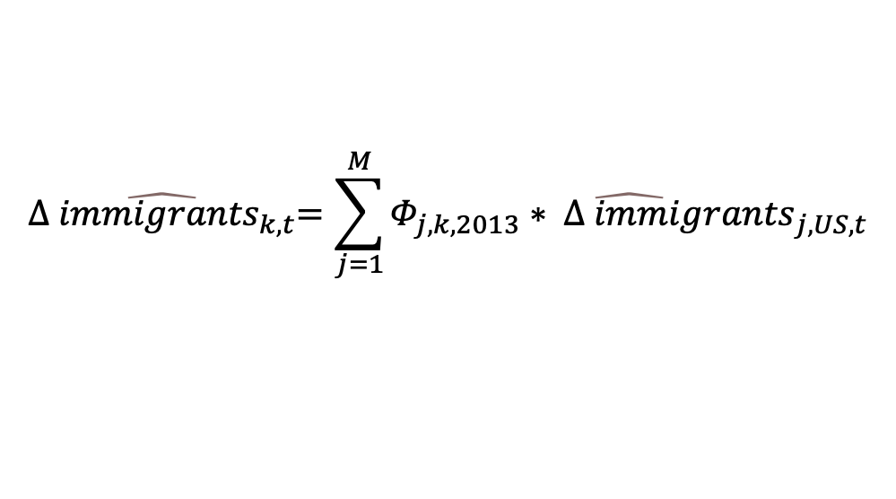
Construction of Shift-Share Instrumental Variable
$$\hat{{∆ immigrants}_{k,t}}=\sum_{j=1}^{M}{\hat{Φ_{j,k,2013}∗ {∆ immigrants}_{j,US,t}}}$$
${∆ immigrants}_{k,t}$= predicted number of new immigrants in MSA k in year t
$Φj,k,2013$ = share of new immigrants from country j in 2013 that settled in MSA k
${∆ immigrants}_{j,US,t}$= predicted number of new immigrants from country j that settled in the U.S. in year t
Some specifications in the literature predict this with models using exogenous factors from origin countries, others use actual immigrant inflows
Introduction
Literature Review
Setting
Data
Empirical Analysis
Robustness Checks
Conclusion

Slide 18
Rationale Behind Shift-Share IV
Predicted immigrant inflows should be correlated with actual immigrant inflows (relevance)
1st stage regression should yield a positive & significant effect
1st stage F-statistic should be > 10
Predicted immigrant inflows should be correlated with housing market outcomes only via their connection with actual immigrant inflows (validity)
The political and economic forces specific to origin countries that motivate immigrants to move to the U.S. should not be linked at all to housing market trends in the U.S.
Introduction
Literature Review
Setting
Data
Empirical Analysis
Robustness Checks
Conclusion

Slide 19
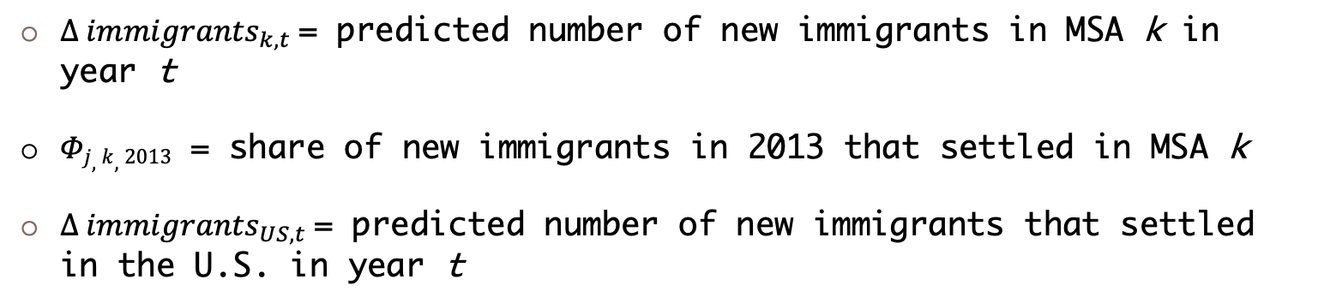
Construction of Shift-Share Instrumental Variable
$$\hat{{∆ immigrants}_{k,t}}=Φ_{k,2013}∗ ∆{immigrants}_{US, t}$$
${∆ immigrants}_{k,t}$= predicted number of new immigrants in MSA k in year t
$Φj,k,2013$ = share of new immigrants in 2013 that settled in MSA k
${∆ immigrants}_{US,t}$= predicted number of new immigrants that settled in the U.S. in year t
Introduction
Literature Review
Setting
Data
Empirical Analysis
Robustness Checks
Conclusion

Slide 20
IV Specification - Results
A 1% increase in immigration relative to MSA population results in a 1.95% increase in rental rates and a 3.12% increase in house prices
OLS results are underestimates
This suggests immigrants are moving to areas where housing costs are growing more slowly
Introduction
Literature Review
Setting
Data
Empirical Analysis
Robustness Checks
Conclusion

Slide 21
Total vs. Partial Effects of Immigration
Much of the literature acknowledges the effect that native mobility in response to immigration can also have on the housing market
Very few studies quantify this effect
Sanchis-Guarner (2023) offers a method of formally separating the partial (direct) demand effect of immigration from the induced demand effect of natives that migrate in response to immigration
Introduction
Literature Review
Setting
Data
Empirical Analysis
Robustness Checks
Conclusion

Slide 22
Decomposition of the Total Effect
$$∆\log\left(Y_{i,t}\right)=β_{1} × \frac{{immigration}_{i, t−1}}{{population}_{i,t−2}}+α×{∆X}_{i,t−1}+×W_{i,t−1} {+ γ}_{i}+λ_{t}+ε_{i,t}$$
Total demand effect of immigration on housing market outcome
$$∆\log\left(Y_{i,t}\right)=β_{2} × \frac{{population}_{i, t−1}}{{population}_{i,t−2}}+α×{∆X}_{i,t−1}+×W_{i,t−1}+ γ_{i}+λ_{t}+ε_{i,t}$$
Partial demand effect of immigration on housing market outcome
$$\frac{{native pop.}_{i, t−1}}{{population}_{i,t−2}}=β_{3} × \frac{{population}_{i, t−1}}{{population}_{i,t−2}}+α×{∆X}_{i,t−1}+×W_{i,t−1}+ γ_{i}+λ_{t}+ε_{i,t}$$
Effect of immigration on native mobility (induced demand effect)
Note: all equations are instrumented using the U.S.-level instrument
Introduction
Literature Review
Setting
Data
Empirical Analysis
Robustness Checks
Conclusion

Slide 23
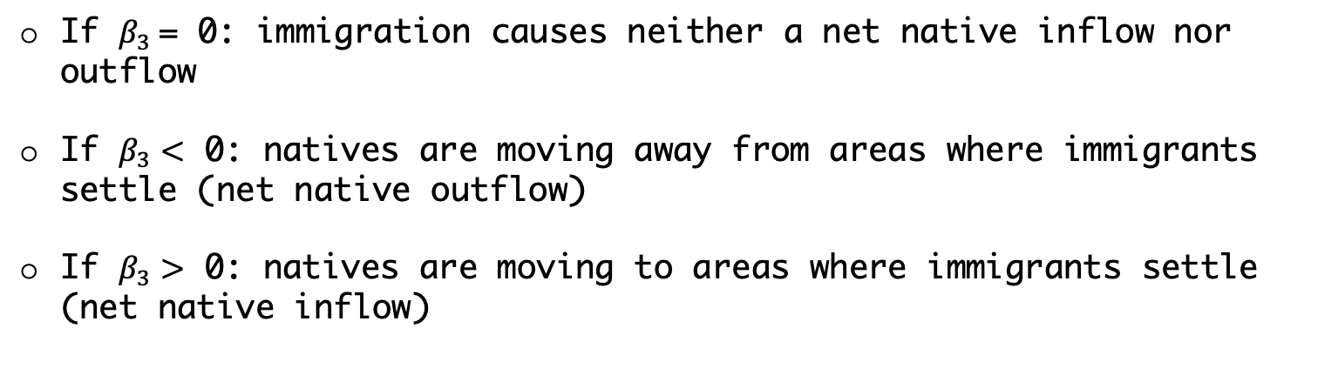
Decomposition of the Total Effect
$β_{1}=β_{2}$ + $β_{2}$ $β_{3}=β_{2}(1+β_{3})$
If $β_{3}$= 0: immigration causes neither a net native inflow nor outflow
If $β_{3}<$ 0: natives are moving away from areas where immigrants settle (net native outflow)
If $β_{3}>$ 0: natives are moving to areas where immigrants settle (net native inflow)
Introduction
Literature Review
Setting
Data
Empirical Analysis
Robustness Checks
Conclusion

Slide 24
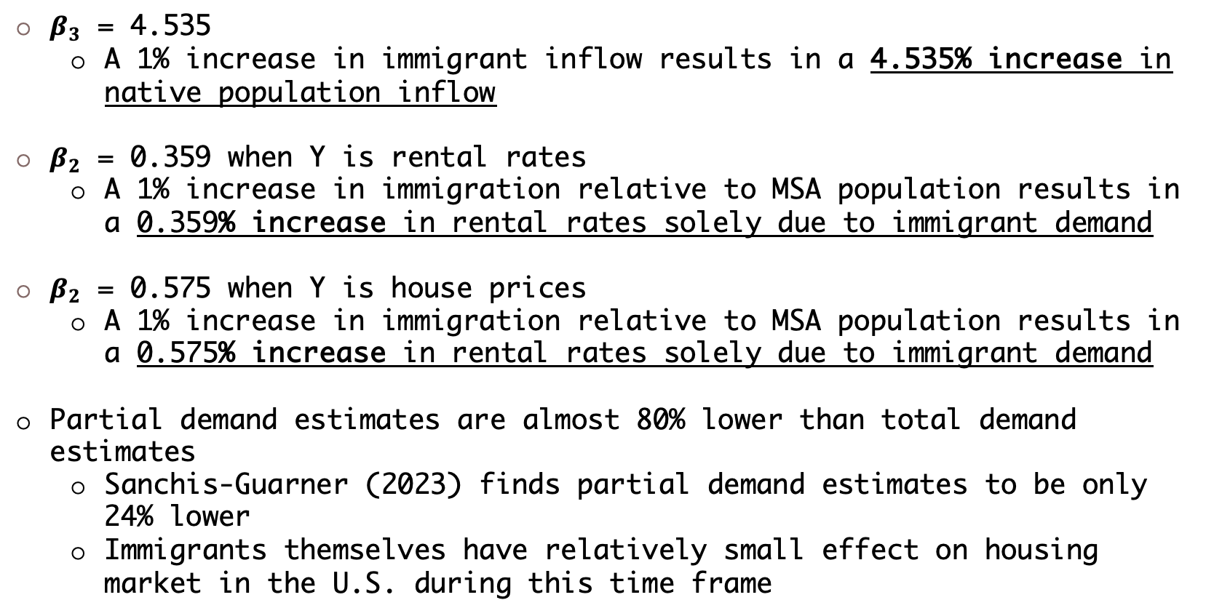
Decomposition of the Total Effect - Results
$β_{3}$ = 4.535
A 1% increase in immigrant inflow results in a 4.535% increase in native population inflow
$β_{2}$ = 0.359 when Y is rental rates
A 1% increase in immigration relative to MSA population results in a 0.359% increase in rental rates solely due to immigrant demand
$β_{2}$ = 0.575 when Y is house prices
A 1% increase in immigration relative to MSA population results in a 0.575% increase in rental rates solely due to immigrant demand
Partial demand estimates are almost 80% lower than total demand estimates
Sanchis-Guarner (2023) finds partial demand estimates to be only 24% lower
Immigrants themselves have relatively small effect on housing market in the U.S. during this time frame
Introduction
Literature Review
Setting
Data
Empirical Analysis
Robustness Checks
Conclusion

Slide 25
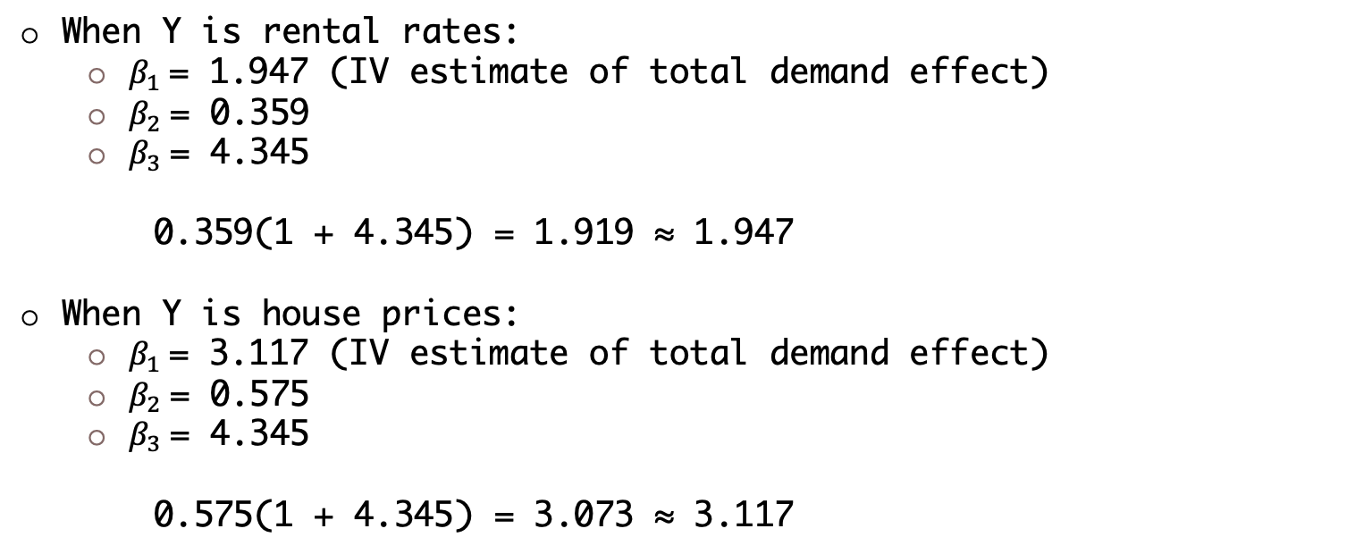
Comparing Decomposition Results & IV Results
When Y is rental rates:
$β_{1}$= 1.947 (IV estimate of total demand effect)
$β_{2}$= 0.359
$β_{3}$= 4.345
0.359(1 + 4.345) = 1.919 ≈ 1.947
When Y is house prices:
$β_{1}$= 3.117 (IV estimate of total demand effect)
$β_{2}$= 0.575
$β_{3}$= 4.345
0.575(1 + 4.345) = 3.073 ≈ 3.117
Introduction
Literature Review
Setting
Data
Empirical Analysis
Robustness Checks
Conclusion

Slide 26
Nonlinear Effects of Immigration
What if the effect of immigration on housing market outcomes differs across the rental rate & house price distributions?
Immigrants tend to demand less expensive housing
Their effect might be stronger in areas where rents/house prices are growing slower or even declining
Introduction
Literature Review
Setting
Data
Empirical Analysis
Robustness Checks
Conclusion

Slide 27
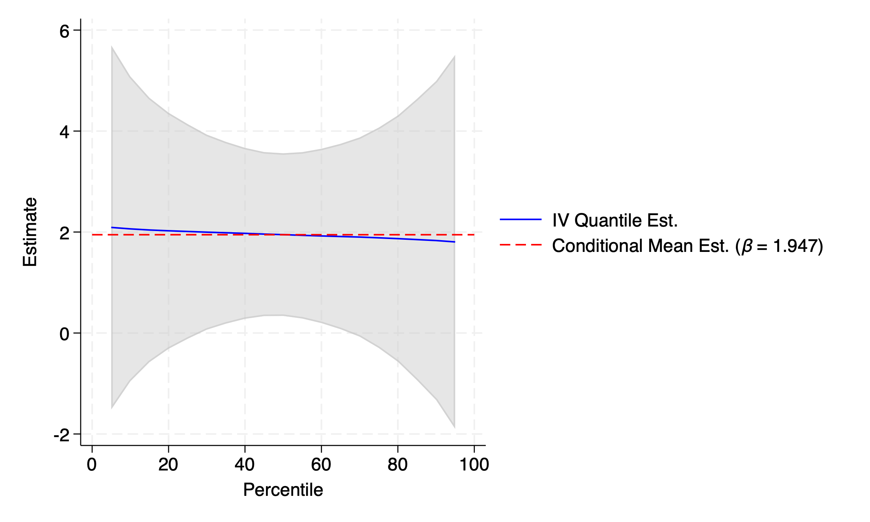
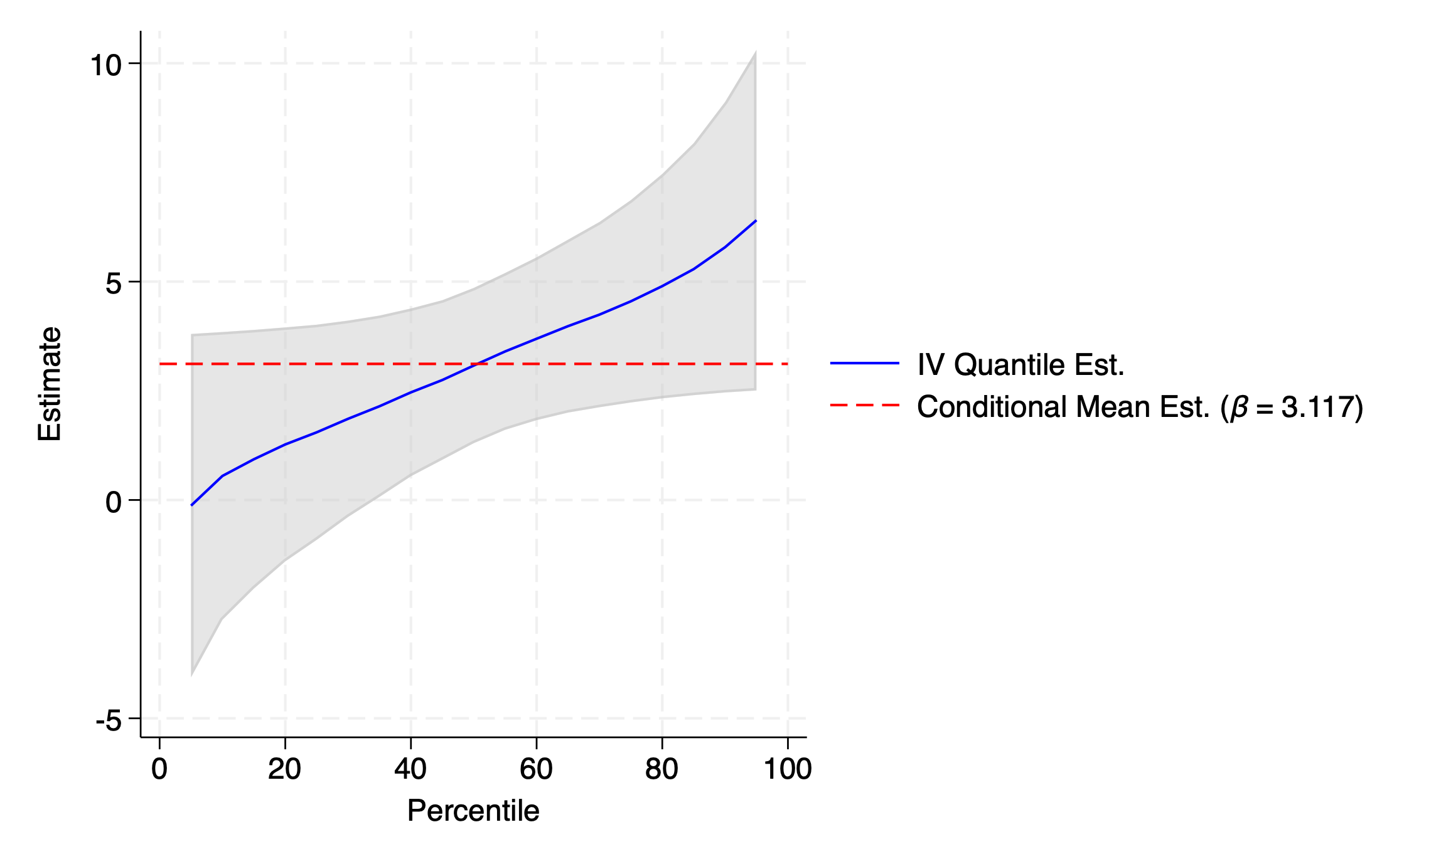
Nonlinear Effects of Immigration - Results
Introduction
Literature Review
Setting
Data
Empirical Analysis
Robustness Checks
Conclusion

Slide 28

Alternative Measure of Immigration
The change in the foreign-born population that entered the U.S. after 2010 may not be the most accurate measure of immigrant inflow
Alternative: use legal permanent resident (LPR) inflow
Data on new LPRs by MSA provided by Office of Homeland Security Statistics (OHSS)
Alternative immigration variable will be defined like so:
$$\frac{{New LPRs}_{i, t−1}}{{population}_{i,t−2}}$$
Introduction
Literature Review
Setting
Data
Empirical Analysis
Robustness Checks
Conclusion

Slide 29
Alternative Measure of Immigration
Due to constraints in OHSS datasets, only 46 MSAs can be used in the sample to test the alternative immigration variable
These MSAs share different qualities than the rest of the original 381-MSA sample
Most of the 46 MSAs are large population that have very high levels of immigrant inflow
Because 46-MSA sample is systematically different from 381-MSA sample, the results from using either sample will not be comparable
I instead compare my results from using both measures of immigrant inflow using only the 46 MSAs in the OHSS dataset
Introduction
Literature Review
Setting
Data
Empirical Analysis
Robustness Checks
Conclusion

Slide 30
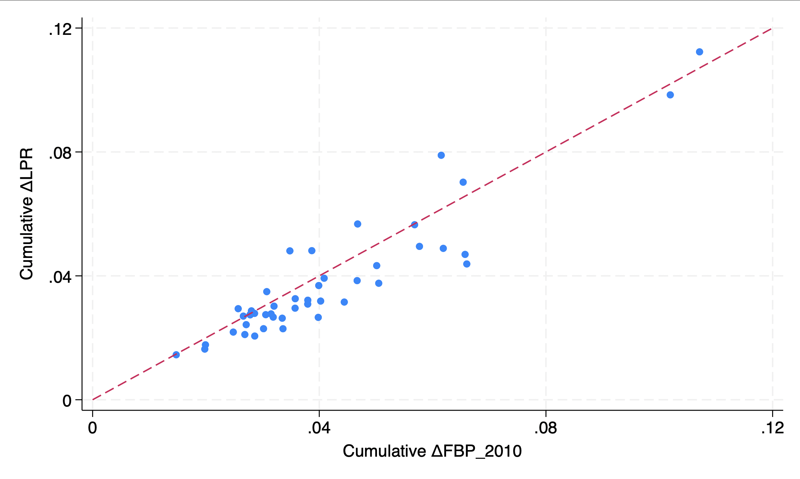
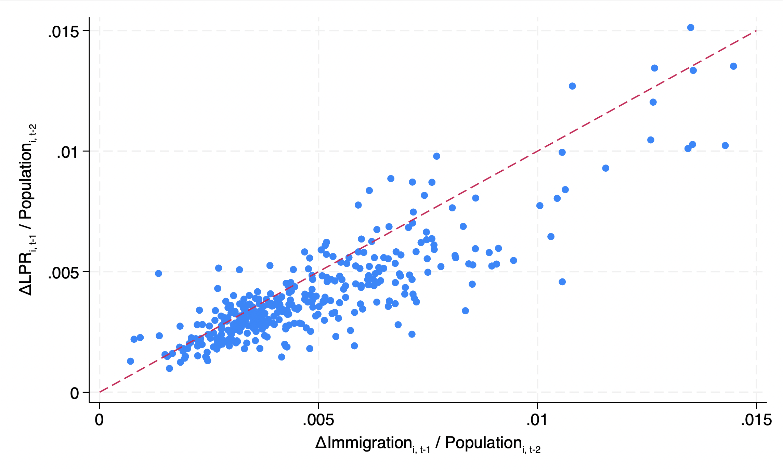
Comparison of Immigration Variables
Introduction
Literature Review
Setting
Data
Empirical Analysis
Robustness Checks
Conclusion

Slide 31
Alternative Immigration Measure - Results
Using the subsample of 46 MSAs:
When immigrant inflows are measured using change in foreign-born population that entered the U.S. after 2010:
A 1% increase in the immigration variable results in an 8.88% increase in rental rates and a 6.95% increase in house prices
When immigrant inflows are measured using new LPRs:
A 1% increase in the immigration variable results in an 6.69% increase in rental rates and a 12.98% increase in house prices
Why might this difference exist?
LPRs often have lived in the U.S. for some time; they may have a better chance of assimilating with native-born individuals
If this the case, their housing preferences might reflect those of natives
Introduction
Literature Review
Setting
Data
Empirical Analysis
Robustness Checks
Conclusion

Slide 32
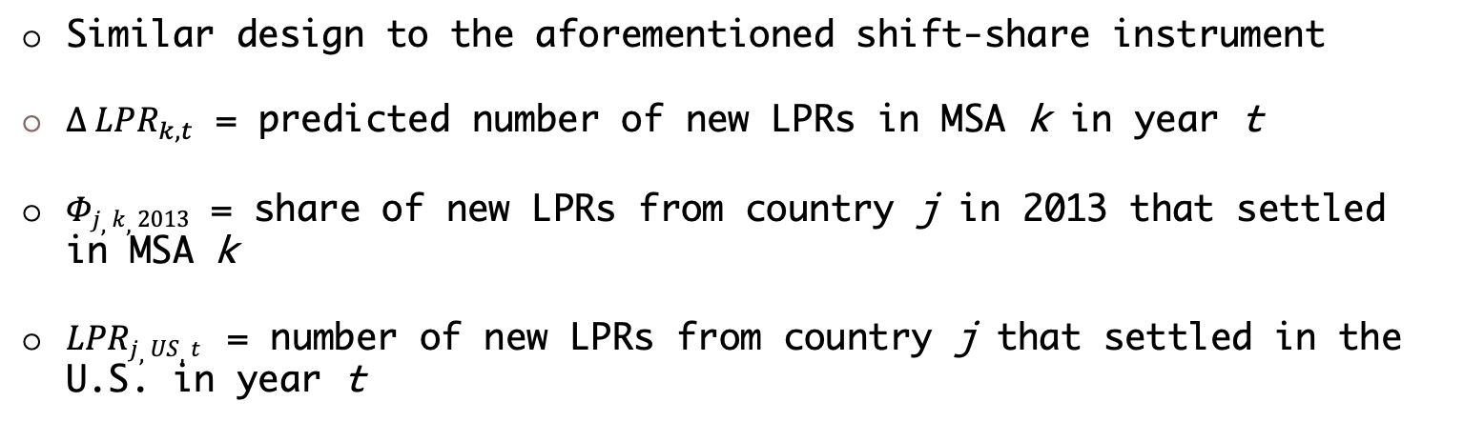
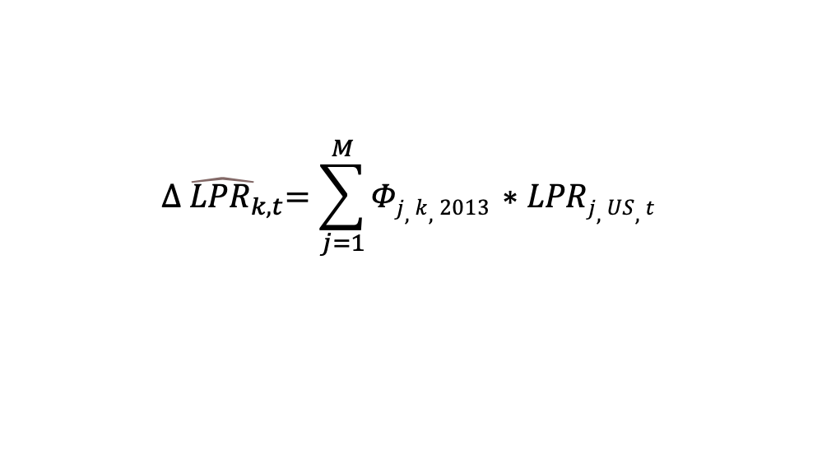
Alternative IV Specification
$$\hat{{∆ LPR}_{k,t}}=\sum_{j=1}^{M}{Φj,k,2013 ∗LPRj,US,t }$$
Similar design to the aforementioned shift-share instrument
${∆ LPR}_{k,t}$ = predicted number of new LPRs in MSA k in year t
$Φj,k,2013$ = share of new LPRs from country j in 2013 that settled in MSA k
$LPRj,US,t$ = number of new LPRs from country j that settled in the U.S. in year t
Introduction
Literature Review
Setting
Data
Empirical Analysis
Robustness Checks
Conclusion

Slide 33
Alternative IV Specification - Results
Using the subsample of 46 MSAs:
When immigrant inflows are measured using new LPRs and instrumented with the U.S.-level instrument:
A 1% increase in the immigration variable results in an 6.69% increase in rental rates and a 12.98% increase in house prices
When immigrant inflows are measured using new LPRs and instrumented with the origin-country shift-share instrument:
A 1% increase in the immigration variable results in an 3.87% increase in rental rates and a 9.91% increase in house prices
Using the origin-country shift-share instrument brings the estimates closer to those observed in the literature—why?
Shift-share instrument is more relevant (i.e., a stronger predictor of actual immigrant inflows)
Introduction
Literature Review
Setting
Data
Empirical Analysis
Robustness Checks
Conclusion

Slide 34
Recap of Results
An increase in immigration equal to 1% of a metropolitan area’s total population results in about a 2% increase in rental rates and a 3% increase in house prices
Immigrants do not seem to be displacing native-born individuals; their migration is complementary
Increases in housing demand directly attributable to immigrants accounts for a small part of the total effect on rental rates and house prices
Partial demand effects are about 80% lower than total demand estimates
Immigration has a substantially larger effect on the upper end of the house price distribution
Introduction
Literature Review
Setting
Data
Empirical Analysis
Robustness Checks
Conclusion

Slide 35
Policy Implications
Arguing that immigration raises the cost of living for native-born individuals, with regards to the housing market, is not a justification for stricter immigration policy
Governments of states and/or municipalities experiencing high levels of immigration should consider expansionary housing supply measures
Issuing more construction permits
Revising city zoning codes
Introduction
Literature Review
Setting
Data
Empirical Analysis
Robustness Checks
Conclusion

Slide 36
Avenues for Future Research
Accounting for supply-side factors and responses
Control for stock of vacant units, availability of land, construction permits, etc.
How do the aforementioned factors respond to increased housing demand from immigration?
Introduction
Literature Review
Setting
Data
Empirical Analysis
Robustness Checks
Conclusion

Slide 37
Thank you for your attention!
Introduction
Literature Review
Setting
Data
Empirical Analysis
Robustness Checks
Conclusion

